Slide 1
Week 29
Mamba relative works

Slide 2
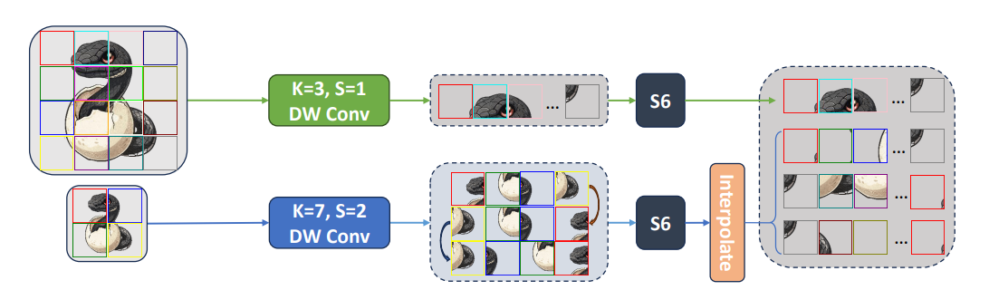
Multi-Scale VMamba: Hierarchy in Hierarchy Visual State Space Model

Slide 3
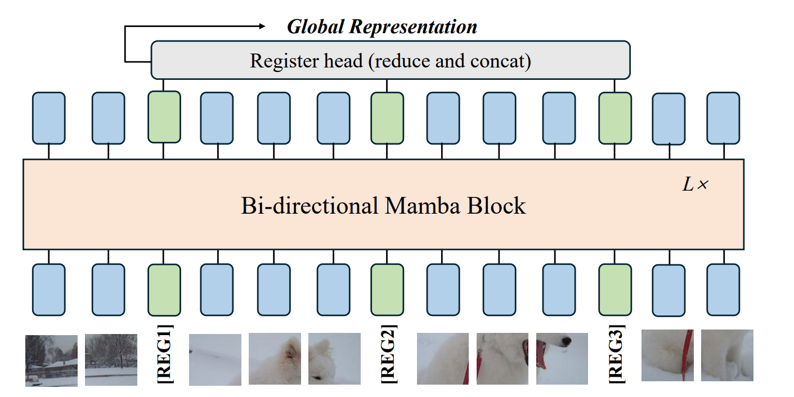
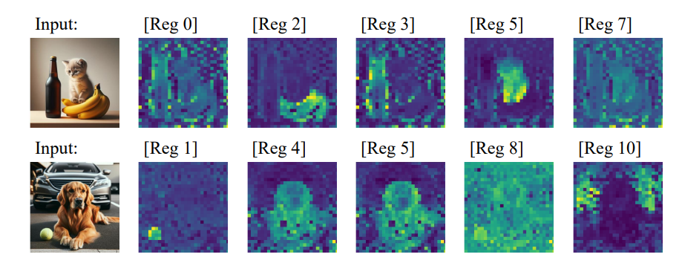
Mamba®: Vision Mamba ALSO Needs Registers

Slide 4
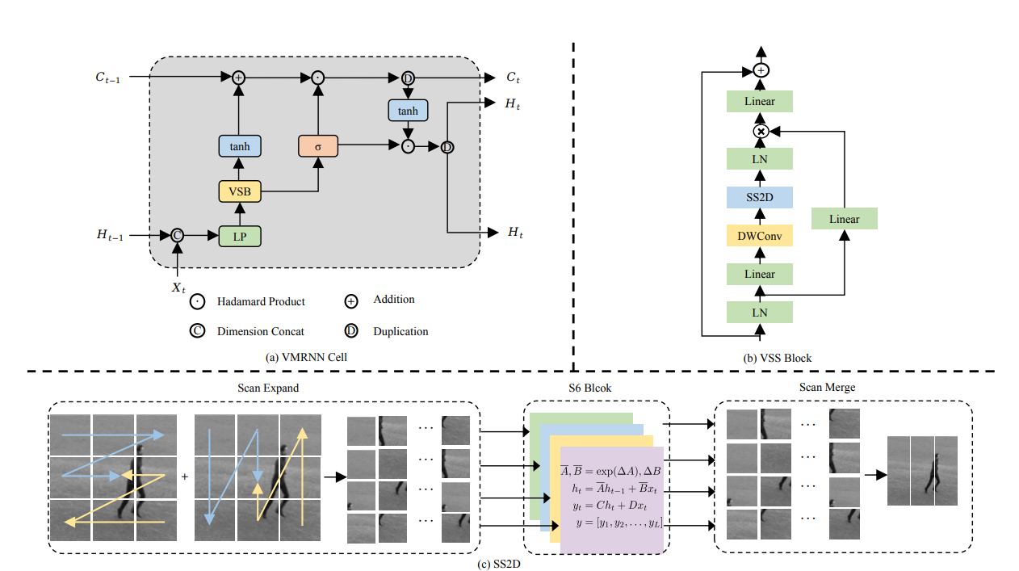
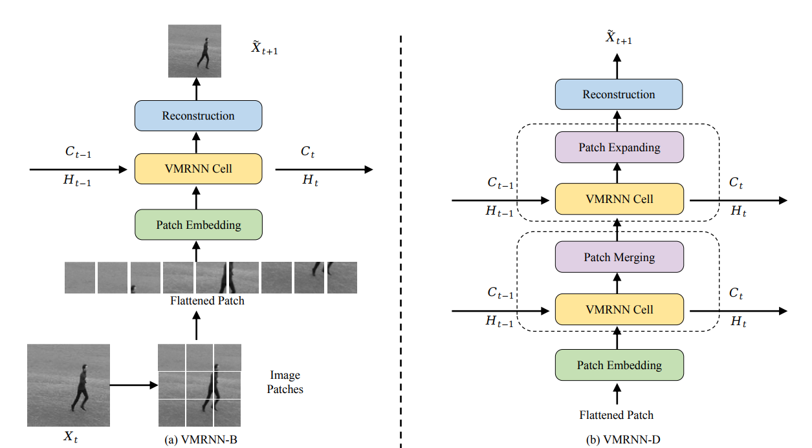
VMRNN: Integrating Vision Mamba and LSTM for Efficient and Accurate Spatiotemporal Forecasting

Slide 5
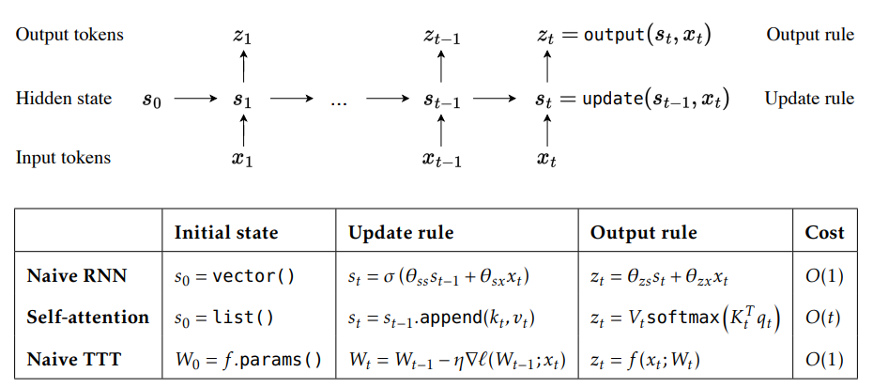
Test-Time Training (TTT)
$$Z_{t}=f\left(x_{t}; W_{t}\right)$$
$$W_{t}=W_{t−1}−η∇l(W_{t−1}; x_{t})$$
$$l\left(W; x_{t}\right)={\left\|f\left({\tilde{x}}_{t};W\right)−x_{t}\right\|}^{2}$$
$$l\left(W; x_{t}\right)={\left\|f\left(θ_{k}x_{k};W\right)−{θ_{v}x}_{t}\right\|}^{2}$$

